Slide 1
Financial Analysis

Slide 2
Introduction
To analyze the competition for the management to provide better results. This data set has information on the market capitalization of the top 500 companies in India

Slide 3
Data Contents
S.No.: Serial number or ranking of the company based on some criteria.
Name: Name of the company.
Mar Cap (Crore): Market capitalization of the company, measured in crore.
Sales Qtr (Crore): Quarterly sales of the company, measured in crore.

Slide 4
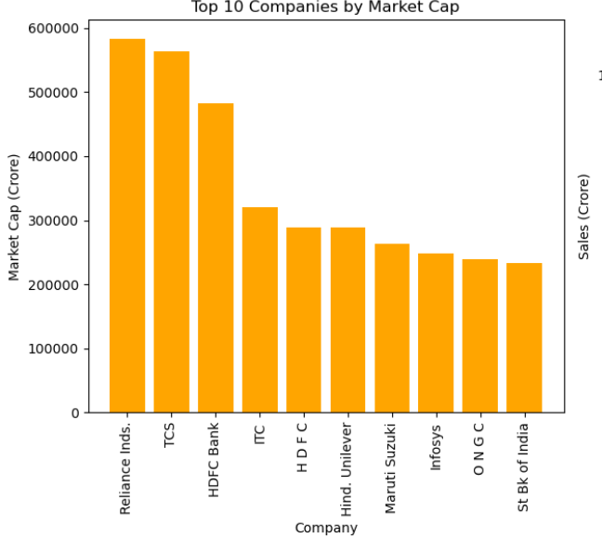
Top 10 companies by market cap(crores)
Reliance is the company with highest market cap followed by TCS and HDFC Bank

Slide 5
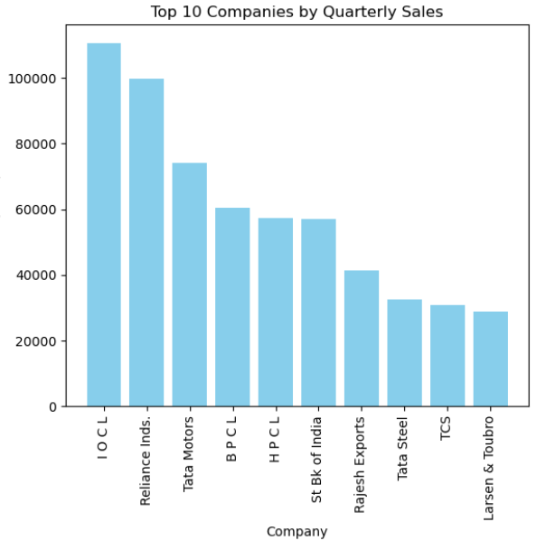
Top 10 companies by Quarterly Sales(crores)
IOCL is the company with highest sales followed by Reliance and Tata Motors

Slide 6
Top 10 companies by market share (%)
S no. | Name | Market share (%)
1 | Reliance Inds. | 16.6
2 | TCS | 16.0
3 | HDFC Bank | 13.7
4 | ITC | 9.1
5 | HDFC | 8.2
6 | Hind. Uniliver | 8.2
7 | Maruti Suzuki | 7.4
8 | Infosys | 7.0
9 | ONGC | 6.8
10 | St Bk of India | 6.6

Slide 7
Thanks

